Slide 1
Big Data for People?
Cross-Disciplinary Approaches to Problem Solving
Cassie DeWitt—Data Scientist & Data Strategist
Pittsburgh Technology Summit, October 2017

Slide 2
Introduction and Overview
BACKGROUND
I HAVE …
TODAY I’LL BE SPEAKING ON…
Professional
●Lead Data Scientist, Detroit Fire Department
●Data Acquisition Specialist, TEKsystems for Ford Motor Company
●ProBono Data Strategy, Analytics
Education
●English Honors Degree (Double Hons), Wayne State University
●Masters of Urban Planning, University of Michigan
●Learned how to utilize analytics and technology to solve problems
●Incorporated a cross-disciplinary focus in my work
●Tested what works and found out what is less productive
●Experimented with how to involve people in the process
●Overview of approach for utilizing urban data science to solve problems for people
●Exploration of selected works
●Proposed application to big data analytics for other organizations / agencies

Slide 3
Widely Used Big Data Terms
Size
Technology
Information
Algorithm
Join
Insight
Modeling
Software
Tools
Infrastructure
Programming
Metrics
Coding
Visualize
Report
Product
Query
AI
Machine Learning
BI
Script
Intelligence
Row
Architecture

Slide 4
Field Obervations
WHAT DRIVES DATA SCIENTISTS TO BIG DATA?
WHERE DOES PASSION INTERSECT BUSINESS PRIORITIES?
WHAT ARE THE FIRST PRINCIPLES THAT NEED TACKLING?
●Interest in solving problems
●Passion for using curiosity
●Application of technology
●Desire to make big data useful
●Motion towards business vision
●Application of analytics to resource optimization
●Interest in creation of products
●Identify reason for analytics/big data
●Understand what analytics will be used for
●Implementation of appropriate skills sets

Slide 5
Informal Survey on Where Field is Headed
SURVEY QUESTION
PROJECTED FUTURE FOCUS AREAS
●I have heard that companies aren't reaping enough value from investment in data science and that there will eventually be an elimination of data science positions
●I would love to hear from friends in tech or data science: does this sound right?
●Automation
●Collaboration
●Return on Investment [ROI]
●Machine Learning
●Production/Engineering
●Product Development
INDICATED CHALLENGES
●Gut-based decisions ●Ill-equipped to log data
●Lack of data-driven culture ●Insight lost as it move upwards
●Minimal synergy ●Lack of creativity
●Low return generation ●Not aligned with speed of mgmt

Slide 6
Survey Results
Source: DeWitt, 2017

Slide 7
Discussion of Survey Results
PRODUCTION / ENGINEERING
COLLABORATION
ROI & MACHINE LEARNING
●Automatic systems focus
●Emphasis on at scale solutions
●Mention of John Deere
●Mention of customer products
●Needed synergy of data science and engineering talent
●Qualitative researchers should complement data scientists
●Data scientists should clean, structure, sort and filter data
●Needed machine learning talent
●Discovery missing from machine learning
●ML commoditization
●Data scientists could transition to ML role

Slide 8
Overview of Utilized Approach

Slide 9
Detroit Fire Department Analytical Project Framework
Operational Problem
Prototype Plan
Review & Feedback
Finalize Plan
DoIT & DFD Critique
Implement Prototype
Collect Data
Improve Prototype
Revised Project Plan
Collect Additional Data
Implement Project
Next Problem
Scheduled Validation
Legend
Start
Project Team*
Notes
*Project team comprises DoIT, key partners, Public Safety IT, and DFD’s Lead Data Scientist
**In this role, DoIT and DFD collaboratively fill the function of traditional critique (questioning assumptions, offering requests for improvement, etc.)
DFD+DoIT**
Stop

Slide 10
Problem Formulation: Listening as an Exercise
Initial Learning Moments
Formulating a problem before listening to the business increases investment of time
Initial Learning Examples
●Modification of Department-Wide Dashboard
●Publication of Open Fire Data
Amended Listening Practices
Began taking more time to listen to pain points and for challenges
Examples of Listening Avenues
●Weekly Cabinet Meetings
●Weekly Key Staff Meeting
●Monthly Community Meetings
●One-on-One Meetings
How to Use Listening to Formulate Great Problem Statements
● Listen first without judging
● Be aware of biases
● Take notes and request confirmation of summary
● Walk through problem statement with client/problem owner

Slide 11
Problem Formulation: Can the Problem Incorporate Analytics?
3 Types of Issues Incorporating Analytics
INFORMATION ISSUE
DECISION ISSUE
SOLUTION ISSUE
Problems characterized by a need for actionable intelligence
Problems characterized by a decision that must be arrived at through a combination of data points
Problems in need of a solution--most usually in the combination of technology+data

Slide 12
Methodology Development
Operation Problem
Develop Problem into Problem Statement
Research How Cities Have Solved the Problem
Decide on Project Questions
Decide How Problem Will Be Tackled
Determine Data and Tech Resources
Develop Statistical and Tech Methods
Package Methodology
Legend
Start
Process Step
Stop
Source: Eastern Michigan University, 2016

Slide 13
Collection of Work Samples
Detroit Fire Department & City of Boston

Slide 14
Analyze Boston Open Data Challenge
Presented at Analyze Boston Open Data Showcase, May 2017

Slide 15
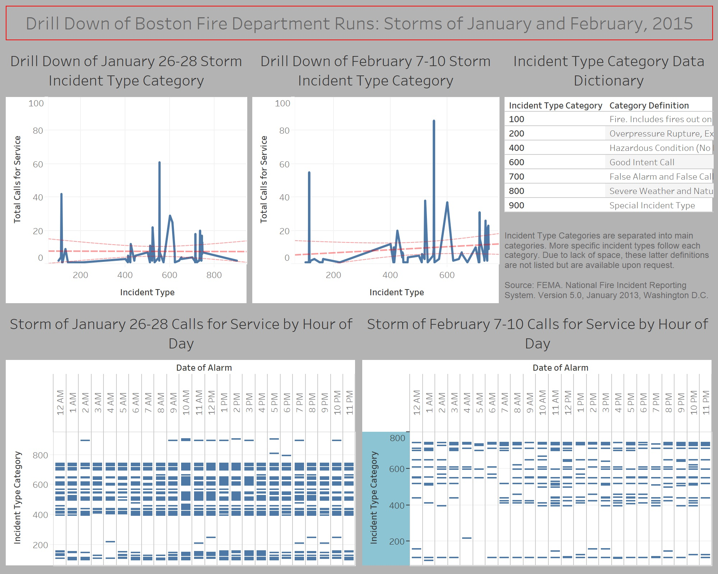
Boston in Winter 2015: Beta Insights Monitor
PROJECT CONCEPTION
Business problem most US fire departments encounter:
●In the event of large-scale maximization of resources, how can fire departments best serve their residents without leaving a gap in service coverage?
Beta product seeks to accomplish:
●Visual story
●Offer an analytical beta product
●Contribute scalable solution

Slide 16
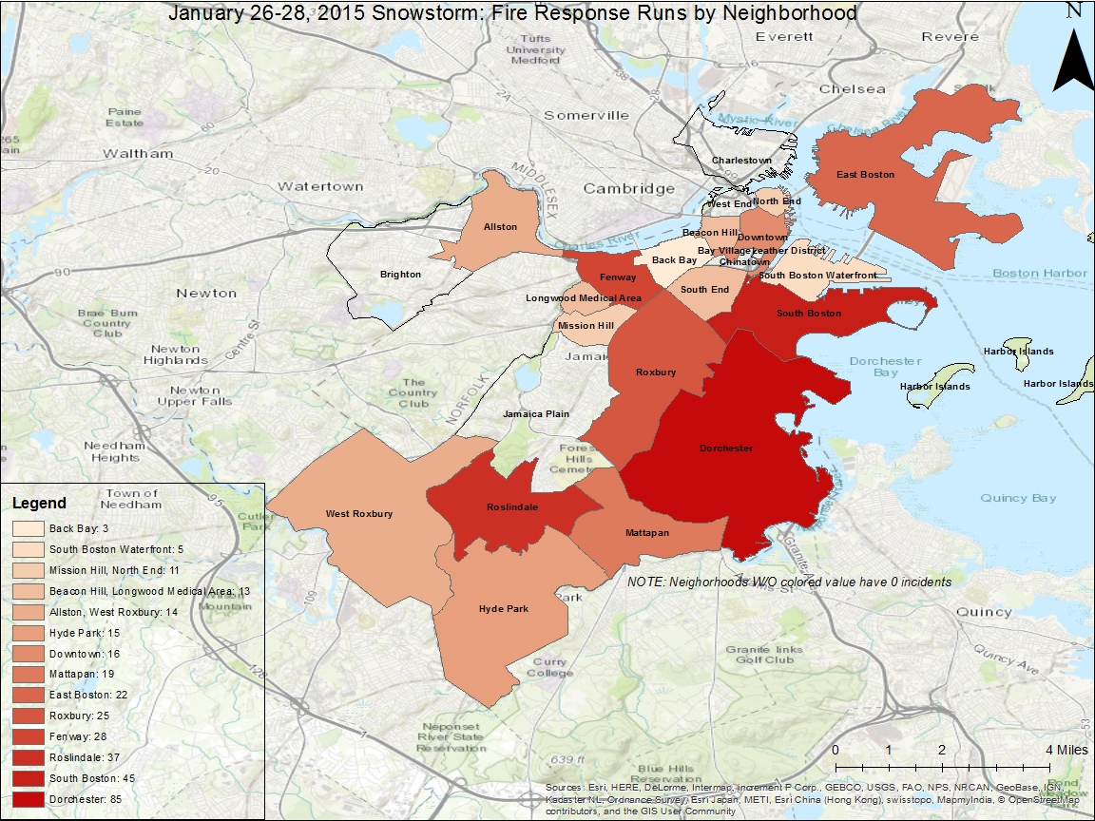
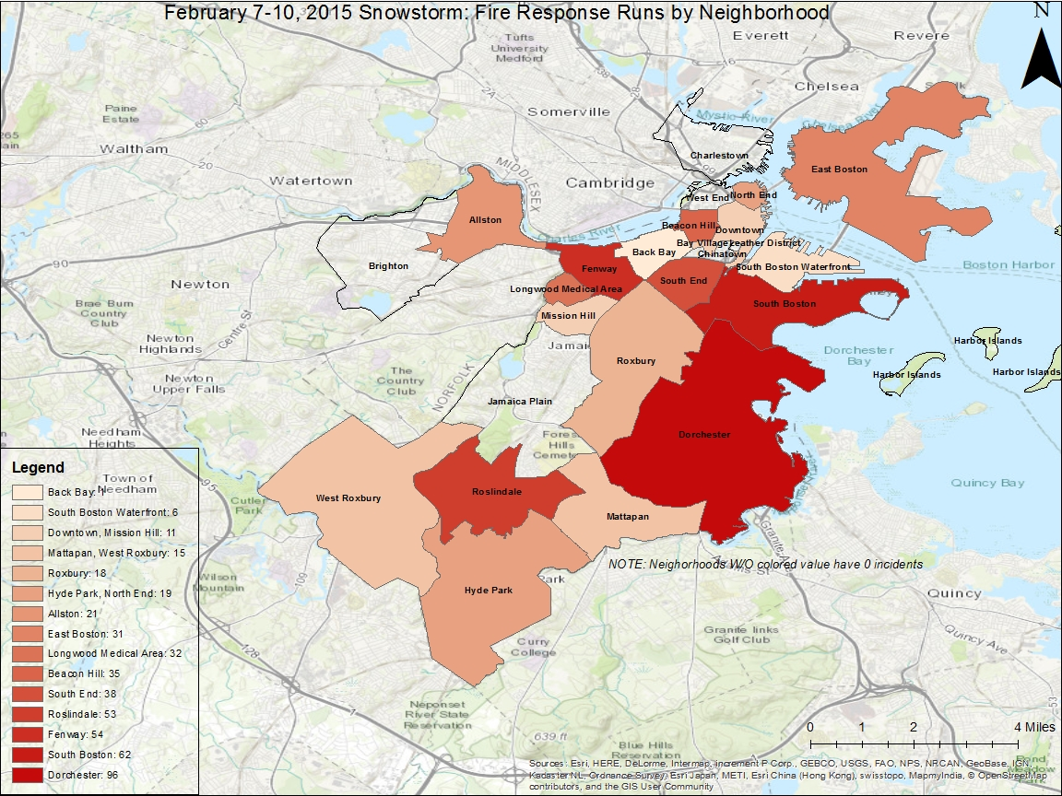
Boston Fire Department Prototype Fire Calls by Neighborhood

Slide 17
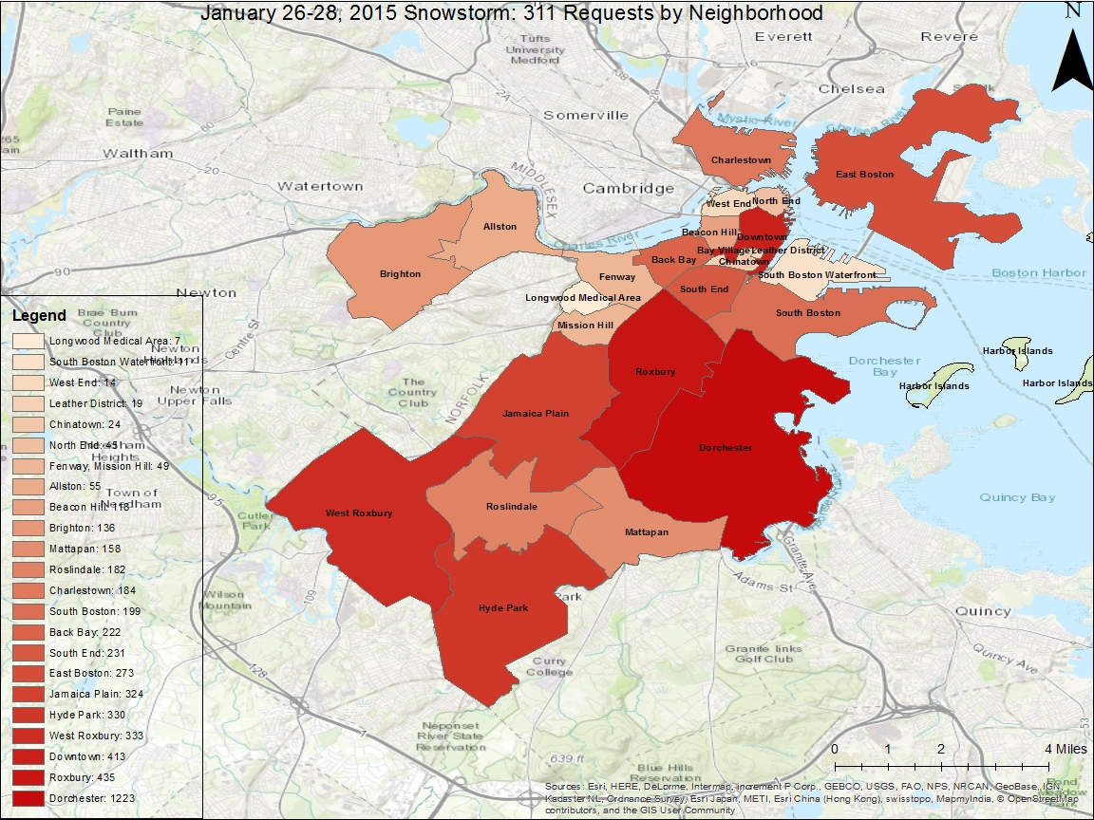
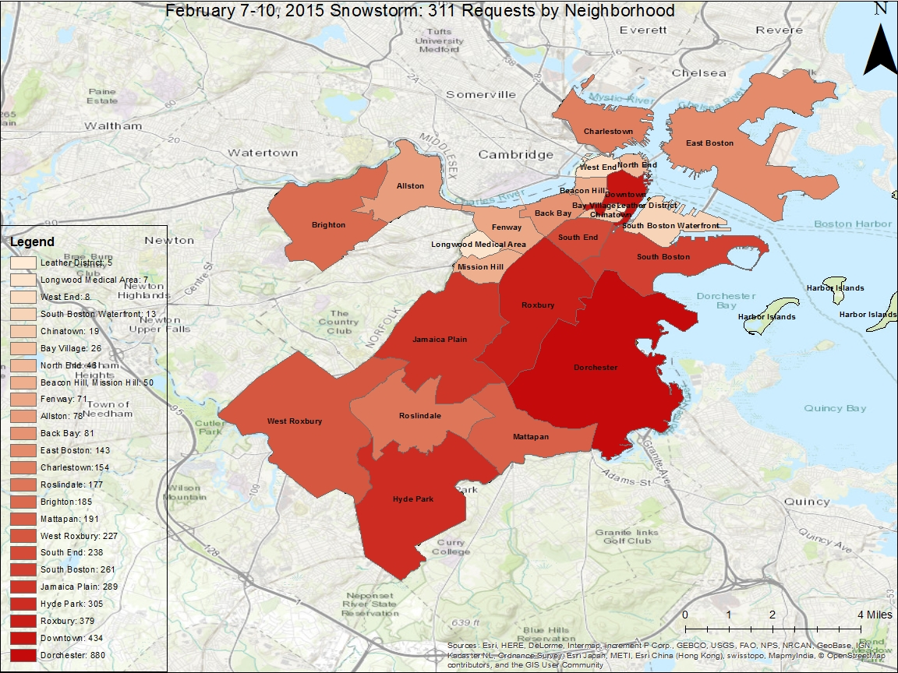
Boston Fire Department Prototype 311 Calls by Neighborhood

Slide 18
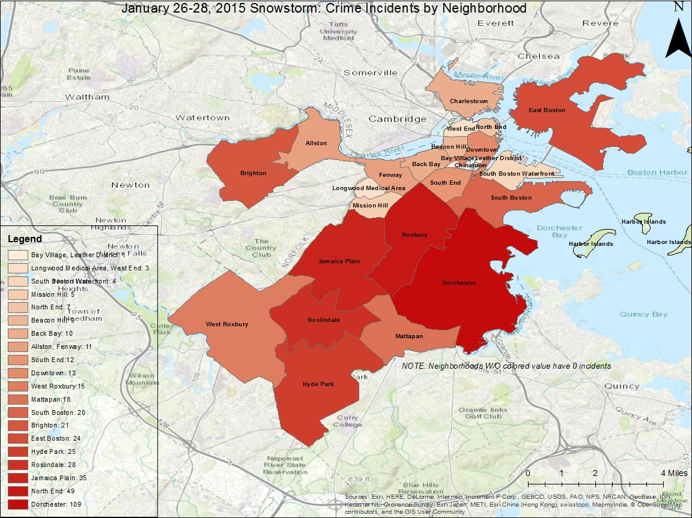
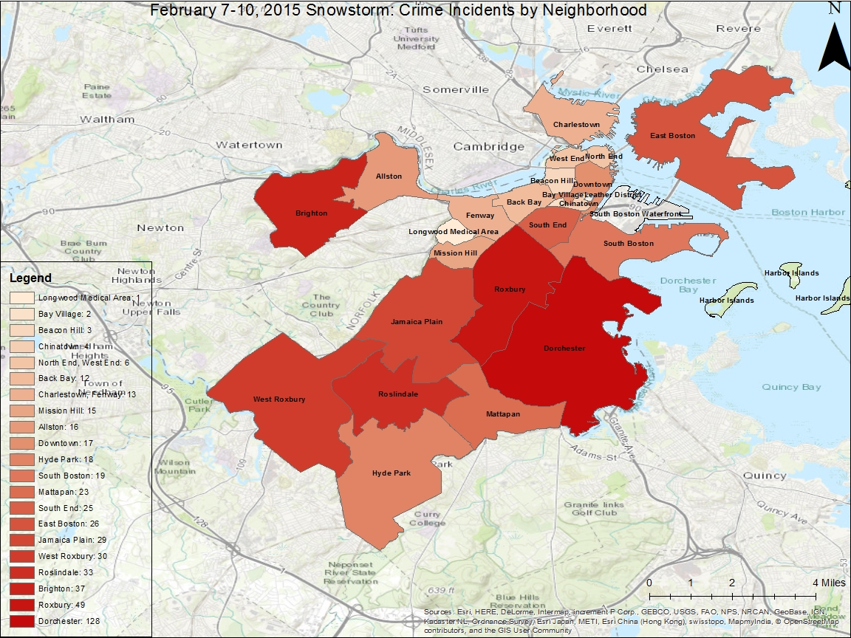
Boston Fire Department Crime Incidents by Neighborhood

Slide 19
Selected Detroit Fire Department Work
January 2015-January 2017

Slide 20
Cited Detroit Fire Department Work
DATA QUALITY PROGRAM
ENGINE 49 ANALYSIS
ISO ANALYSIS
Implementation of data quality program that weekly monitored and addressed data quality issues
Comprehensive analysis of Engine 49 feasibility
Analysis of response time, response time gaps and apparatus deployment

Slide 21
Cited Detroit Fire Department Work
DEPARTMENT-WIDE METRIC REVIEW
OPEN DATA PORTAL
CAMPAIGN INTELLIGENCE
Weekly review of performance metrics
Publishing of fire data on City of Detroit’s open data site
Fast-paced intelligence projects such as Angels’ Night in October

Slide 22
Utilized Tools
SPATIAL ANALYTICS
PERFORMANCE METRICS
INTENSIVE ANALYTICS
Combination of ArcGIS Desktop, ArcGIS Online and assistance of ESRI
Attempted Tableau first but DFD was more familiar with Excel
Secondary reliance on R but primary reliance on Excel

Slide 23
Big Data for People:
Application of Urban Analytics to Organizations
January 2017-Current

Slide 24
Big Data for Cities
50% of World’s Population Lives in Cities Today (World Health Organization, 2017)
Big Data Can Help Identify Cause of Congestion (Clifford, 2017)
Forecasting Improvements of Congestion and Behavior Nudging (Neumann, 2015)
IBM Helping City of Dublin Use Big Data for Traffic Congestion (Analytics Magazine, 2017)

Slide 25
Big Data for People
RECALLING SURVEY RESPONSES
EVOLVING DATA CONSUMPTION
ROOM FOR CREATIVE APPLICATIONS
●Forecasted disruption
●Future focus on production /engineering
●Collaboration focus
●Third focus areas:ROI & machine learning
●Acceptance of techology & analytics in Detroit
●In certain circumstances data & technology can solve problems
●People want to use data & technology to solve problems
●Opportunity for placing the user first
●Opportunity for directly integrating the voice of customer
●Opportunity for improving the way data scientists work

Slide 26
Desirable Products People Love That Allow Them To Have:
EMPOWERMENT
SOLUTIONS
OPTIMIZATION
An understanding of insights and how they can apply these insights to implement their vision or goal
A derived satisfaction of a problem being solved or a solution being obtained
A more efficient use of resources that gives individuals the freedom to use gained revenue to further accomplish goals

Slide 27
Creative Insight and Solution Generation
NEW INSIGHT INTO OLD PROBLEMS
CREATIVE APPLIATION OF SOLUTIONS
PHASED RISK OF SOLUTIONS
An application of curiosity derived from cross-collaborative teams; providing an unique perspective on old problems (Grant, 2017)
A brain storming with multiple skillsets on how optimization solutions can be scaled up and/or applied to different problems
A tolerance of risk but in a strategic manner (Grant, 2017)

Slide 28
Data Ethics in Age of Big Data
UNIVERSAL ISSUE
AWARENESS
HOW CAN DATA SCIENTISTS RESPOND?
Private sector, public sector and non-profit sector *all share the challenge of data ethics
Data scientists should always be aware of their own biases
●Rely on data science community
●Work in teams
●Team up with machine learning experts

Slide 29
Final Thoughts
ON BIG DATA
ON DATA FOR PEOPLE
ON ETHICS
An approach to big data analytics does not have to start with big data
●The field may be facing disruption
●The anticipated disruption brings an opportunity to incorporate people
●Ethics is being placed more and more at forefront
●Knowing how to respond is key

Slide 30
Thank You and Discussion
Cassie DeWitt | cassiedewitt@gmail.com |@cassie_dewitt

Slide 31
Source Citations
Analytics Magazine (2017). Big Data Helps City of Dublin Improve Public Bus Transportation and Reduce Congestion. Analytics:Driving Better Business Decisions. Retrieved October 13, 2015, from http://analytics-magazine.org/big-data-helps-city-of-dublin-improve-public-bus-transportation-and-reduce-congestion/
Clifford, T (2017, March 30). 5 Urban Transportation Challenges that Big Data Can Help You Solve. Retrieved October 13, 2015, from http://blog.streetlightdata.com/5-urban-transportation-challenges-that-big-data-can-help-you-solve
DeWitt, C (2017, October 15) LinkedIn Post. Retrieved from https://www.linkedin.com/feed/update/urn:li:activity:6314491066687070208
Grant, A (2017) Originals: How Non-Comformists Rule the World. NYC, NY: Penguin Books
Neumann, Carl-Stefan (2015). Big Data Versus Big Congestion: Using Information to Improve Transport. McKinsey. Retrieved October 13, 2015, from https://www.mckinsey.com/industries/capital-projects-and-infrastructure/our-insights/big-data-versus-big-congestion-using-information-to-improve-transport
World Health Organization (2017). Global Health Observatory (GHO) Data: Urban Population Growth. Retrieved October 13, 2015, from http://www.who.int/gho/urban_health/situation_trends/urban_population_growth_text/en/

